Slide 1
Coronavirus Pandemic State of Emergency
Purpose: Education for EMS Providers. Anything presented is subject to change – and we need to get used to it.
UPDATE: 3/26/2020
SARS-CoV-2 / Virus responsible for Covid-19
(pka 2019-nCoV / Novel Coronavirus)
Christopher Hill, D.O.
Topics
Summary of EMS Guidance
Personal Protective Equipment
New Protocols
Member:
Notes:
Severe Acute Respiratory Syndrome Coronavirus 2

Slide 2
Background Covid-19 Infection
Incubation period ≈4 days (2-7 days)
Common symptoms:
Fever, Cough, myalgia, fatigue, SOB
Lesser common symptoms:
Sore throat, headache, cough with sputum production, hemoptysis
Very early symptoms may include: loss of smell or taste
UPDATED

Slide 3
Background Covid-19 Infection
UPDATED
Some of the sickest patients had initial mild-moderate symptoms and later had significant deterioration (hypoxia) starting between days 7 and 14.
Commonly: bilateral, multi-focal pneumonia
WHO / March 13, 2020:
81% - mild or uncomplicated illness
14% - severe disease (hospitalization and oxygen support)
5% - Intensive Care Unit required
Time from symptom onset to significant illness (including ARDS) ≈8 days
Notes:
20-30% of admitted patients require ICU
Hospital Mortality Rate: 15%; 49% for critically ill; reported that 61.5% of patients died by day 28 of ICU admission
Expect prolonged ICU stays and ventilator support, ARDS (higher PEEP, lower TV protocol)
Many patients needing >6 LPM will progress to endotracheal intubation

Slide 4
Background Covid-19 Infection
UPDATED
Risk Factors
AGE (especially >60 years old)
Co-morbid Conditions
Diabetes, Heart Disease, immunosuppressive medications, chronic lung disease, or chronic kidney disease
Exposure to a patient with Covid-19 (Healthcare worker, law enforcement, residential facility staff, family member, those living in congregate settings, etc.)

Slide 5
Guidance for EMS
Summary

Slide 6
UPDATED
PSAPs in Iowa have been asked to screen. Inquire, if they don’t tell you.
Fever (subjective or confirmed) or Respiratory Illness (cough or SOB)
International travel history or any cruise in the past 14 days
Live with, cared for or had close contact (<6Ft for >2 min) with person who has tested positive for Covid-19 OR is visibly sick (i.e., sneezing, coughing) OR says they are sick with fever or respiratory symptoms.
If dispatch advises of a suspicious patient, PPE should be applied before entering the scene.
Initial assessment of every patient with respiratory illness should begin from a distance of at least 6 feet from the patient, if possible. RE-perform the screening questions.
If possible, ask the patient to walk outdoors to do the initial evaluation
Patient contact should be minimized to the extent possible until a surgical type facemask is on the patient.
Notes:
SOURCE CONTROL using a facemask on the patient is a priority. IF having a severe PPE shortage/crisis: EMS provider should wear a mask and ask the patient to cover mouth/face with what is available (non-medical mask, tissue, etc).

Slide 7
Personal Protective Equipment – DIRECT CARE PROVIDER
Per Dr. Hill
UPDATED
Wear a surgical face mask to every patient call, regardless of patient’s complaint.
EMS Providers​ who will directly care or transport/transfer a patient with possible ​COVID-19 infection or who will be in the compartment with the patient
If known to be positive, the results unknown, or infection is suspected (respiratory symptoms, fever, etc.):
Standard, Droplet, Eye, and Contact Precautions
Single pair of disposable patient examination gloves.
Disposable isolation gown
Respiratory protection (Surgical Mask)
Eye protection (i.e., goggles or disposable face shield that fully covers the front and sides of the face).
If performing an aerosol generating procedure (list on next slide):
Standard, Airborne, Eye, and Contact Precautions
Single pair of disposable patient examination gloves.
Disposable isolation gown
Respiratory protection (N-95 / respirator / PAPR)
Eye protection (i.e., goggles or disposable face shield that fully covers the front and sides of the face)
Link to a PPE Training Video
Notes:
These recommendations may / likely will change – as further studies regarding transmission become available, based on national guidelines, and contingent upon the supply chain.
Reuse recommendations anticipated – (e.g, place mask in a breathable, labeled container – careful not to touch inside of mask)
Vice President Pence asked that industries (such as construction) donate their N-95 Respirators to local hospitals (I would argue: local EMS…); CONTACT local industries now to discuss.
Re-use / Extended Use recommendations available on the CDC Website for PPE conservation strategies based on severity of PPE shortage.

Slide 8
Aerosolizing Procedures
Per Dr. Hill
UPDATED
CPR
Bag-Valve Mask (BVM) Ventilation
Oropharyngeal airway (OPA)/Nasopharyngeal airway (NPA)
Endotracheal intubation
King Airway or iGel is a safer, recommended alternative for EMS
Nebulizer
CPAP or BiPAP
Oropharyngeal Suctioning
National Supply Chain Concerns with PPE
N-95/Respirators should be prioritized for aerosol-generating procedures
Notes:
Re-use / Extended Use recommendations available on the CDC Website for PPE conservation strategies based on severity of PPE shortage.

Slide 9
Personal Protective Equipment – DRIVER
Per Dr. Hill
Drivers that provide direct patient care (e.g., moving patients onto stretchers) should wear all above recommended PPE.
After completing patient care and before entering the driver’s compartment, the driver should remove and dispose of PPE (except mask or respirator) and perform hand hygiene to avoid soiling the compartment.
When possible, use vehicles that have isolated driver and patient compartments that can provide separate ventilation to each area.
For a vehicle without an isolated driver compartment, open the outside air vents in the driver area and turn on the rear exhaust ventilation fans to the highest setting to create a negative pressure gradient toward the patient area.
During transport, vehicle ventilation in both compartments should be on non-recirculated mode to maximize air changes that reduce potentially infectious particles in the vehicle.

Slide 10
Other Guidance
Per Dr. Hill
During transport, limit the number of providers in the patient compartment to essential personnel to minimize possible exposures.
No passengers should ride in the ambulance (except 1 masked parent with a minor)
Considerations for the safety of an unattended child if EMS patient is the parent
If a nasal cannula or other oxygen is used, apply a mask over it.
If possible, consult with medical control before performing aerosol-generating procedures for specific guidance.
If possible, the rear doors of the transport vehicle should be opened and the HVAC system should be activated during aerosol-generating procedures. This should be done away from pedestrian traffic.
Notify the receiving healthcare facility that the patient has an exposure history and/or signs and symptoms suggestive of ​COVID-19​ infection so that appropriate infection control precautions may be taken prior to patient arrival.
Notes:
Beware of changing rules by hospitals – they may have you arrive to a different entrance

Slide 11
Other Guidance
Per Dr. Hill
After transporting the patient, leave the rear doors of the transport vehicle open to allow for sufficient air changes to remove potentially infectious particles.
After the patient is released to the facility, remove and discard PPE and perform hand hygiene.
Documentation of patient care should be done after EMS providers have completed transport, removed their PPE, and performed hand hygiene.
EMS documentation should include a listing of EMS clinicians and public safety providers involved in the response and level of contact with the patient (for example, no contact with patient or provided direct patient care). This documentation may need to be shared with local public health authorities.

Slide 12
Post-Call Cleaning/Sanitizing
Per Dr. Hill
When cleaning the vehicle, EMS providers should wear a disposable gown and gloves. A face shield, or facemask and goggles should also be worn if splashes or sprays during cleaning are anticipated.
Doors should remain open when cleaning the vehicle.
Routine cleaning and disinfection procedures
All surfaces that may have come in contact with the patient or materials contaminated during patient care (e.g., stretcher, rails, control panels, floors, walls, work surfaces) should be thoroughly cleaned and disinfected
Clean and disinfect reusable patient-care equipment before use on another patient, according to manufacturer’s instructions.
Follow standard operating procedures for the containment and disposal of used PPE and regulated medical waste.
Follow standard operating procedures for containing and laundering used linen. Avoid shaking the linen.

Slide 13
EMS providers who have been exposed to a patient with potential or confirmed COVID-19​ should notify their chain of command to ensure appropriate follow-up.
Any unprotected exposure (e.g., not wearing recommended PPE) should be reported to your chain of command, the receiving health care facility, and local public health.
EMS providers should be alert for fever or respiratory symptoms (e.g., cough, shortness of breath, sore throat). If symptoms develop, they should self-isolate immediately, then make proper notifications.
UPDATED
As Healthcare Professionals, all of us should be self-monitoring for symptoms or fever!

Slide 14
Important Messages
Per Dr. Hill
CONSERVE PPE; use it appropriately
Do NOT work if you are ill (fever, cough, cold-like symptoms)
All personnel should avoid touching their face while working
Social Distancing – applies to stations
No more than 3-5 people in any room (including training)
Keep 6 feet between yourself and other crew members, patients, hospital staff, your family, and the public whenever possible.
Complete a checklist for surface disinfecting at all sites (BID or more often)
Railings, door handles, light switches, faucets, bathrooms/toilets/handles, living or other shared areas, tables, desks, keyboards/mouse, pens, etc.
Wash your hands hourly while awake, even if no calls
Do NOT wear your work clothes home. Change at work and bag them.
Carefully place in washing machine.
Wash your hands before leaving and immediately after returning home.

Slide 15
UPDATED
NEW PROTOCOL: In effect immediately and until further notice.
Albuterol Inhaler – Substitution for Nebulizers
These are protocols and guidance documents were composed for several EMS services who share common EMS medical directors across northeast Iowa, working in collaboration (Dr. L. Fagre, Dr. W. Fangman, Dr. C. Hill, and Dr. C. Joylani), and these are approved for use by their services only.

Slide 16
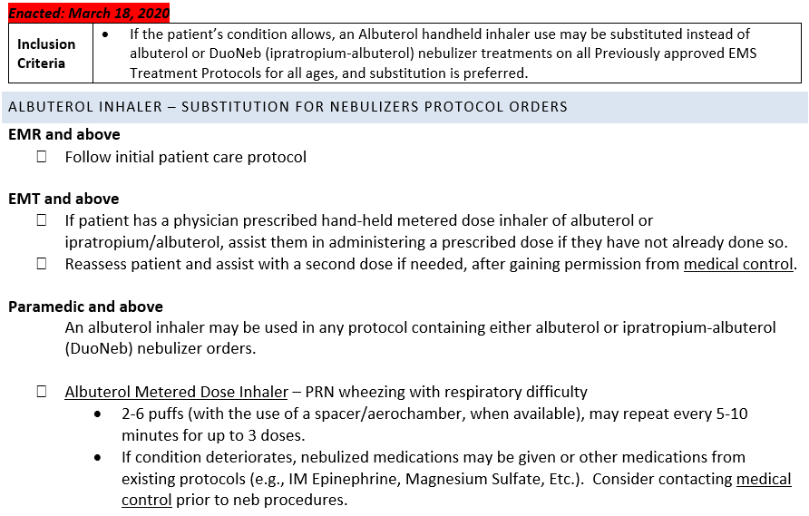
AVOID THE use of albuterol nebulizers in the field, if possible. Consult with Medical Control if any questions.
UPDATED
Notes:
AVOID THE use of albuterol in the field, if possible. Consult with Medical Control if any questions.

Slide 17
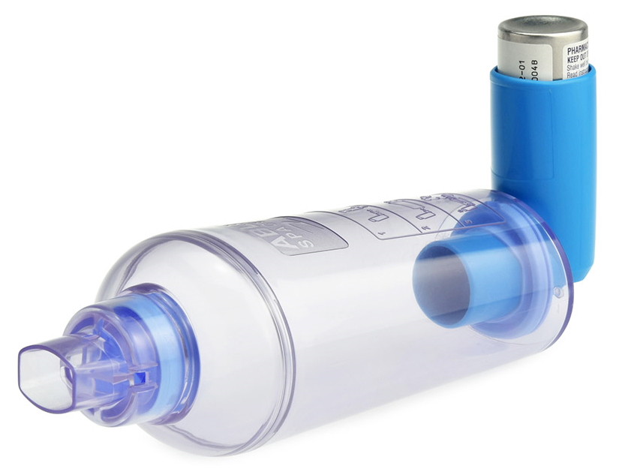
Spacer Device
“Puff” (while mouth is covering mouth piece)
Then, slow/deep inhale
HOLD breath
Then fully, slowly exhale
Notes:
Spacer improves the effectiveness of albuterol inhaler drug delivery. If no Spacer, then pay close attention to the timing for “puffing” and breathing in at the same time.

Slide 18
NEW PROTOCOL: In effect immediately and until further notice.
Evaluate/Release and Alternative Destination
These are protocols and guidance documents were composed for several EMS services who share common EMS medical directors across northeast Iowa, working in collaboration (Dr. L. Fagre, Dr. W. Fangman, Dr. C. Hill, and Dr. C. Joylani), and these are approved for use by their services only.
UPDATED

Slide 19
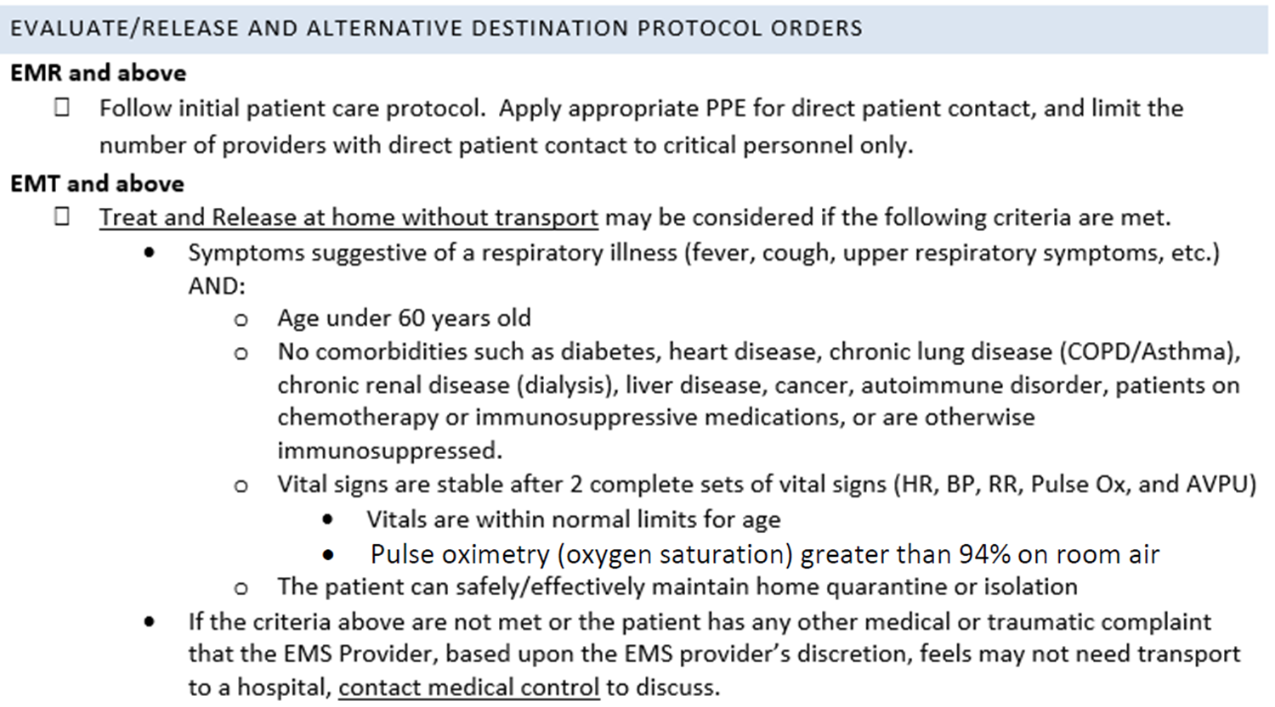
UPDATED
Continued…

Slide 20
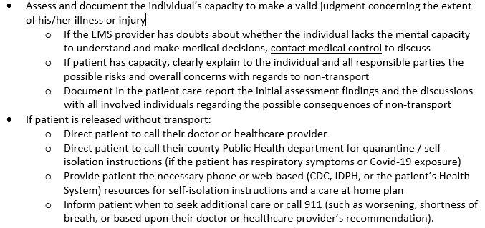
UPDATED

Slide 21
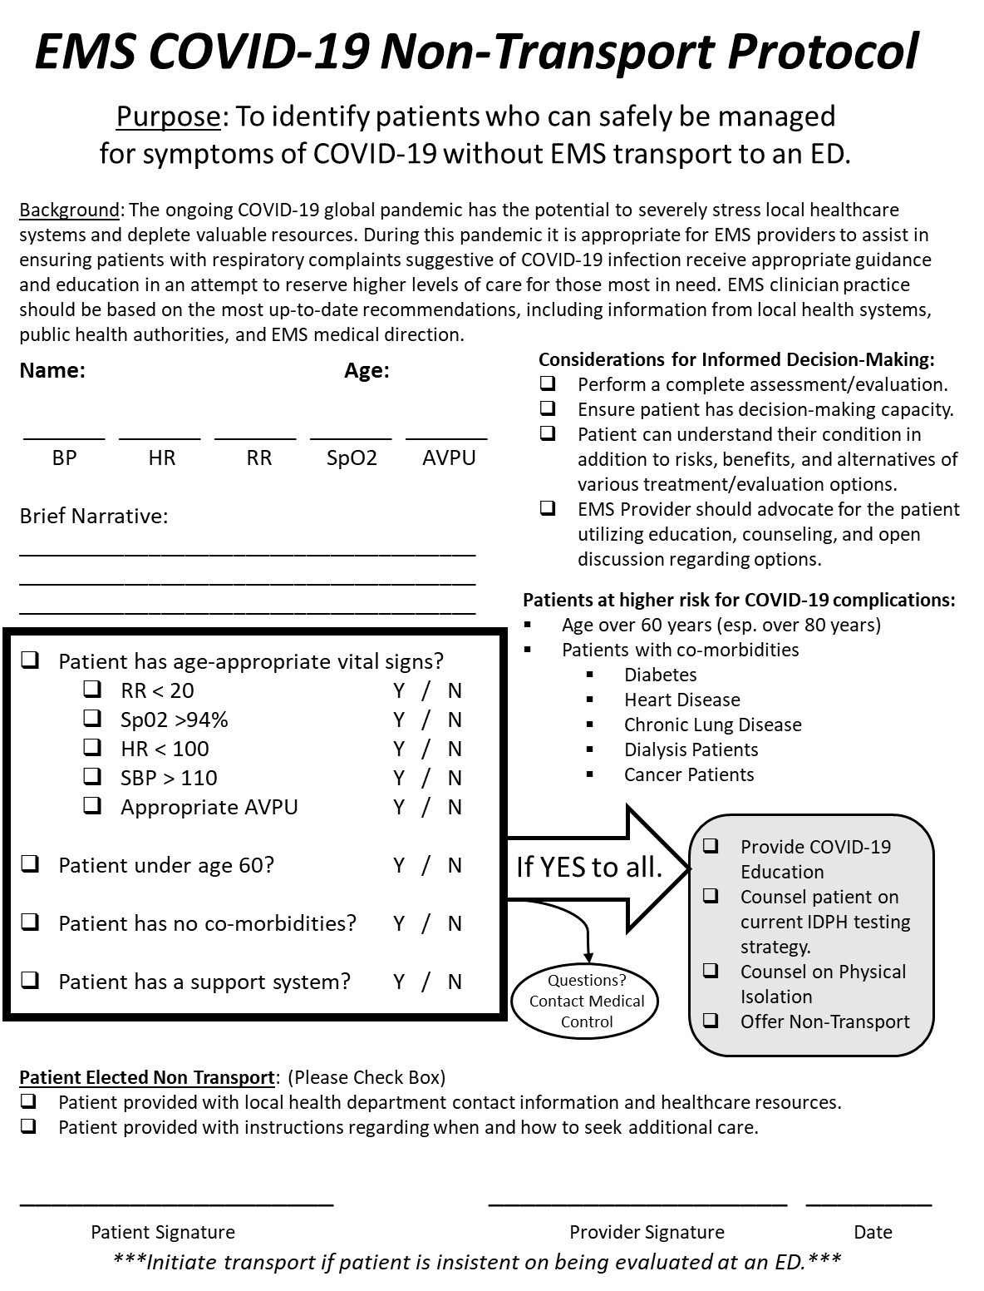

Slide 22
NEW PROTOCOL: In effect immediately and until further notice.
Use of Tele-Technology
These are protocols and guidance documents were composed for several EMS services who share common EMS medical directors across northeast Iowa, working in collaboration (Dr. L. Fagre, Dr. W. Fangman, Dr. C. Hill, and Dr. C. Joylani), and these are approved for use by their services only.
UPDATED

Slide 23
UPDATED

Slide 24
Closing Remarks

Slide 25
Final Thoughts
Stay calm and continue your everyday Bravery.
Be ready to improvise (you’re EMS, that’s what you do), and closely monitor e-mails and announcements
Procedures, rules, regulations, protocols, etc. may change several times
AVOID GETTING SICK – you/EMS are foundational to an effective healthcare response to the Pandemic.
Social Distancing out of work
Sanitize home surfaces (faucets, counters/tables, etc) several times daily
Isolate any sick family member to one room.
Dedicate one bathroom. If not possible, sanitize after every use by the family member.
TAKE CARE of your physical and your mental health
Be open about fears/anxieties, support one-another, support your family and friends.

